Slide 1

PSYC100 GENERAL PSYCHOLOGY
DEVELOPMENTAL PSYCHOLOGY

Slide 2
LEARNING OUTCOMES
Early experiences and attachment
Development of self concept
Cognitive development and Piaget’s Theory
Zone of Proximal Development - Vygotsky

Slide 3
I - What is attachment?
According to Kagan et al. (1978), an attachment is: ... an intense emotional relationship that is specific to two people, that endures over time, and in which prolonged separation from the partner is accompanied by stress and sorrow.
Our first attachment acts as a prototype (or model) for all later relationships.
Harlow’s experiments with monkeys
John Bowlby
Mary Ainsworth

Slide 4
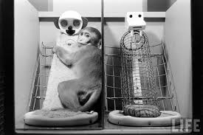
Harlow’s monkey experiments
To study whether attachment in infants is based on biological needs (feeding) or emotional comfort (contact and security).
https://www.youtube.com/watch?v=-Qi7txH1KzY
https://www.youtube.com/watch?v=OrNBEhzjg8I
Monkeys overwhelmingly preferred the cloth mother, even though she provided no food.
They only went to the wire mother briefly to feed, then immediately returned to the cloth mother.
Surrogate Mother | Description | Provided Milk?
Wire Mother | Bare wire frame | ✅ Yes (bottle attached)
Cloth Mother | Covered in soft terry cloth | ❌ No (no milk)

Slide 5
Harlow’s follow-up studies
Isolation studies: Monkeys raised in total isolation (no mother, no peers) became emotionally disturbed, socially withdrawn, and often self-harming; When reintroduced to others, they were fearful or aggressive and struggled to mate or care for offspring.
Partial isolation studies: Monkeys could see and hear others but not touch them; Still developed abnormal behaviors, showing that physical affection and social contact are crucial.
CONCLUSIONS:
Attachment is not just about feeding — it’s about security, comfort, and love.
Touch and emotional warmth are essential for healthy psychological development.
Lack of attachment can lead to severe long-term emotional damage.

Slide 6
John Bowlby (1950s-60s)
Bowlby, a British psychologist, was the first to propose that attachment is an innate biological system that evolved to ensure survival (evolutionary).
He argued that children are born with an instinct to seek closeness to a caregiver when they feel threatened, frightened, or ill.
The caregiver provides a secure base from which the child can explore the world and a safe haven for comfort.
The critical period for forming primary attachment according to Bowlby is roughly from birth to about 3 years of age
https://www.youtube.com/watch?v=f1Jw0-LExyc

Slide 7
John Bowlby (1950s-60s)
Bowlby believed that infants display a strong innate tendency to become attached to one particular adult female (not necessarily the natural mother).
For Bowlby (1951): Mother love in infancy is as important for mental health as are vitamins and proteins for physical health.
Although Bowlby didn’t deny that children form multiple attachments, he saw attachment to the mother as being unique: it’s the first to develop and is the strongest of all.
However, Schaffer and Emerson showed that multiple attachments seem to be the rule rather than the exception. FATHERS!

Slide 8
Mary Ainsworth (1970s)
Ainsworth expanded Bowlby’s theory with her “Strange Situation” experiment (1970s), which observed how infants reacted to separations and reunions with their mothers.
Studied how infants (12-18 months old) form attachments and react to separation and reunion with their caregiver.
Identified 4 main attachment styles.

Slide 9
Step | Who’s in the room | What happens | What psychologists observe
1 | Parent + baby | Parent and baby enter room. | Infant’s willingness to explore.
2 | Parent + baby | Baby explores with parent nearby. | Use of parent as a secure base.
3 | Parent + baby + stranger | Stranger enters, talks to parent, then approaches baby. | Reaction to stranger.
4 | Baby + stranger | Parent quietly leaves. | Separation anxiety.
5 | Parent + baby | Parent returns, comforts baby; stranger leaves. | Reaction to reunion.
6 | Baby alone | Parent leaves baby completely alone. | Separation distress.
7 | Baby + stranger | Stranger re-enters, offers comfort. | Ability to be soothed by stranger.
8 | Parent + baby | Parent returns again. | Second reunion response.

Slide 10
Findings of SSE
Attachment Type | % of Infants | Key Behaviors
Secure | ~65% | Explores freely with caregiver as secure base; distressed when caregiver leaves; easily comforted upon return.
Insecure-Avoidant | ~20% | Explores freely; shows little distress when caregiver leaves; avoids or ignores caregiver upon return.
Insecure-Resistant (Ambivalent) | ~10–15% | Clings to caregiver, little exploration; highly distressed when caregiver leaves; seeks comfort but also resists it upon return.
Disorganized (added later) | ~5–10% | Contradictory or confused behavior (e.g., approaching but looking away); often linked to trauma or neglect.
https://www.youtube.com/watch?v=QTsewNrHUHU

Slide 11
Four attachment styles
Attachment Style | Child Behavior | Later Adult Traits
Secure | Distressed when caregiver leaves, comforted when they return | Trusting, emotionally stable, comfortable with intimacy
Avoidant (Insecure-avoidant) | Indifferent to caregiver’s departure/return | Emotionally distant, values independence, avoids closeness
Ambivalent / Resistant (Insecure-ambivalent) | Very distressed when separated, not easily comforted | Clingy, overly dependent, fears abandonment
Disorganized | Confused or contradictory behaviors | Fearful of intimacy, trauma-related patterns

Slide 12
Deprivation and Privation

Slide 13
Are the effects of privation reversible?
Yes!
Case studies of children who’ve endured extreme early privation, often in near complete isolation.
e.g. Czech twins
2. Studies of late adoption
e.g. Romanian orphanages

Slide 14
Czech Twins (Andreas and Petr, discovered 1972, age ~7)
After their mother died, their stepmother locked them in a cellar or unheated room with almost no human contact, light, or stimulation until age 7 (along with an older brother who was less affected).
At discovery: almost no speech, severe intellectual disability (IQ ~40), autistic-like behaviors, no social attachment.
Outcome after intensive rehabilitation: dramatic recovery. By adolescence their IQs rose to low-normal range (~90–100), they developed normal language and social relationships, finished school, and lived relatively normal adult lives.
Romanian Orphanages
Led by Michael Rutter, Jana Kreppner, and others since the early 1990s.
Background: After the 1989 fall of Ceaușescu in Romania, the world discovered thousands of children in state orphanages with extreme deprivation:
Almost no caregiver interaction (ratios sometimes 1:30–1:60 for infants); Minimal language exposure, little play, severe malnutrition in early years; Many children spent months/years lying in cots with almost no stimulation.
There is a clear sensitive period: deprivation lasting beyond roughly 6 months markedly increases risk; beyond 24 months the risk is very high.

Slide 15
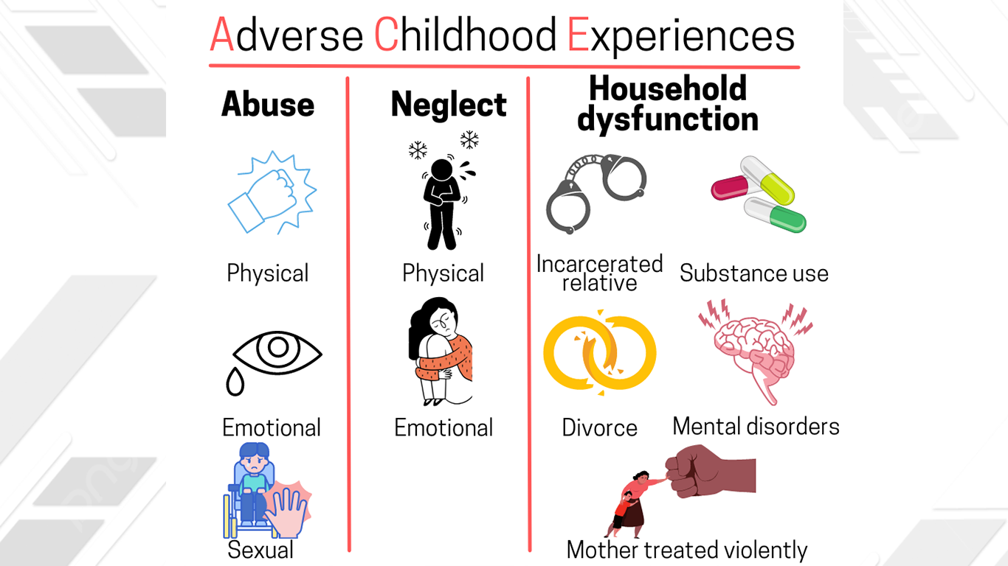
ACE and attachment
Attachment theory and Adverse Childhood Experiences (ACEs) are two deeply interconnected concepts in psychology and health research, both highlighting the profound, long-term impact of early life experiences on an individual's physical and mental well-being, as well as their relationships throughout life.

Slide 16
II – The Self Concept
‘Self ’ and ‘self-concept’ are used interchangeably to refer to an individual’s overall self-awareness.
According to Murphy (1947), ‘the self is the individual as known to the individual’.
Components of the self-concept are self-image (WHO AM I?), self-esteem (HOW I FEEL ABOUT MYSELF?), ideal-self (WHO I WANT TO BE?).

Slide 17
Developmental changes in the self-concept
During the first few months, the baby gradually distinguishes itself from its environment and from other people.
According to Maccoby (1980), babies are able to distinguish between themselves and others on two counts:
1. their own fingers hurt when bitten (but they don’t have any such sensations when they’re biting their rattle or their mother’s fingers)
2. probably quite early in life, they begin to associate feelings from their own body movements with the sight of their own limbs and the sounds of their own cries.
Gallup (1977) studies on chimps

Slide 18
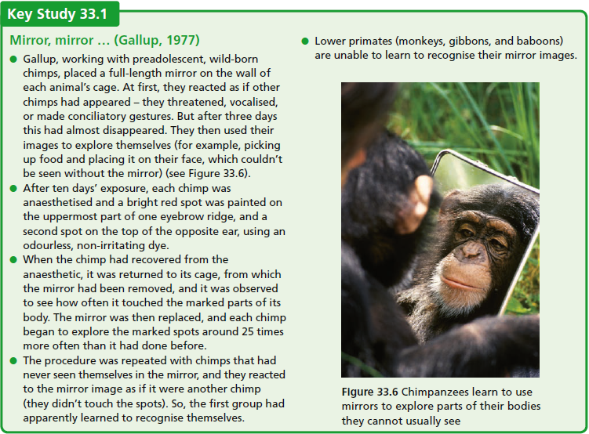
Lewis and Brooks-Gunn (979) have used modified forms of Gallup’s technique with 6- to 24-month-old children. The mother applies a dot of rouge to the child’s nose (while pretending to wipe its face), and the child is observed to see how often it touches its nose. It is then placed in front of a mirror, and again the number of times it touches its nose is recorded. While touching the dot was never seen before 15 months, between 15 and 18 months, 5–25 per cent of infants touched it, and 75 per cent of the 18- to 24-month-old infants did.

Slide 19
III – Cognitive development
According to Piaget, cognitive development occurs through the interaction of innate capacities with environmental events, and progresses through a series of hierarchical, qualitatively different, stages.
All children pass through the stages in the same sequence without skipping any or regressing to earlier ones
The stages are also the same for everyone irrespective of culture (they’re universal).
Underlying the changes are certain functional invariants, fundamental aspects of the developmental process which remain the same and work in the same way through the various stages. The most important of these are assimilation and accommodation.
The principal cognitive structure that changes is the schema (plural schemas or schemata).

Slide 20
Assimilation and accommodation
Assimilation is the process of taking in new information and fitting it into existing schemas (mental categories) without changing those schemas.
  E.g. A child knows about dogs: they’re furry, have four legs, and bark. When the child sees a cat for the first time, they might call it a “dog” because it also has four legs and fur. The child is assimilating the new animal into their existing “dog” schema.
Accommodation is the process of modifying existing schemas or creating new ones when new information doesn’t fit the old schema.
  E.g. After being corrected that the cat is not a dog, the child learns that cats meow and have different behaviors. The child then creates a new “cat” schema separate from “dog.” This is accommodation — adjusting the schema to include new distinctions.

Slide 21
Stages of cognitive development (Piaget, 1952)

Slide 22
Sensorimotor Stage
0-2 yrs
Infants understand their world primarily through sensory experiences and physical (motor) interactions with objects
  Object Permanence: the understanding that an object continues to exist even when it cannot be seen
  Piaget claimed that infants younger than 9 months do not have a mental representation of objects

Slide 23
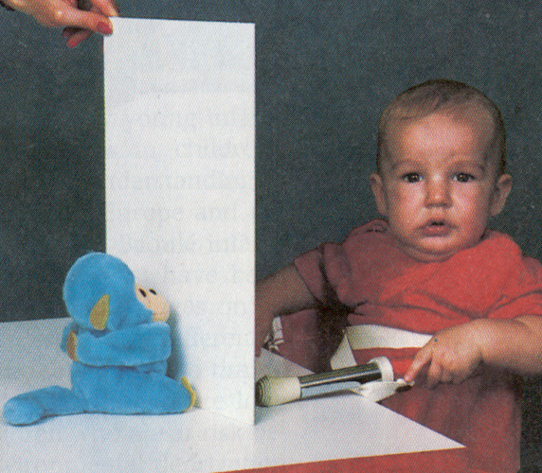
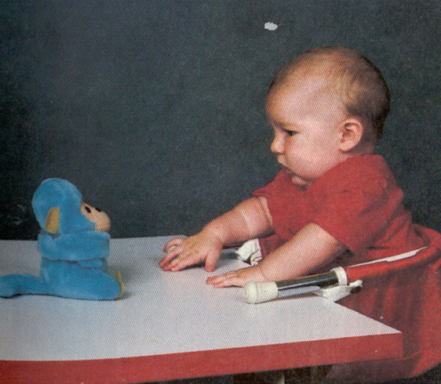
Object permanence

Slide 25
Pre-operational stage
2-7 yrs
The world is represented symbolically through words and mental images; no understanding of basic mental operations or rules
No understanding of Principle of Conservation: basic properties of objects stay the same even though their outward appearance may change e.g. water in differently shaped glasses
Egocentrism: difficulty in viewing the world from someone else’s perspective e.g. three mountains task
Irreversibility: cannot mentally reverse actions e.g. pouring back the water into glass A
Animism: the belief that inanimate objects are capable of actions and have lifelike qualities e.g. the sidewalk was mad and made them fall down

Slide 26
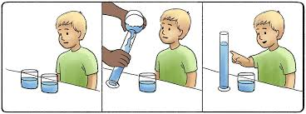
Example: Principle of Conservation

Slide 27


Slide 28
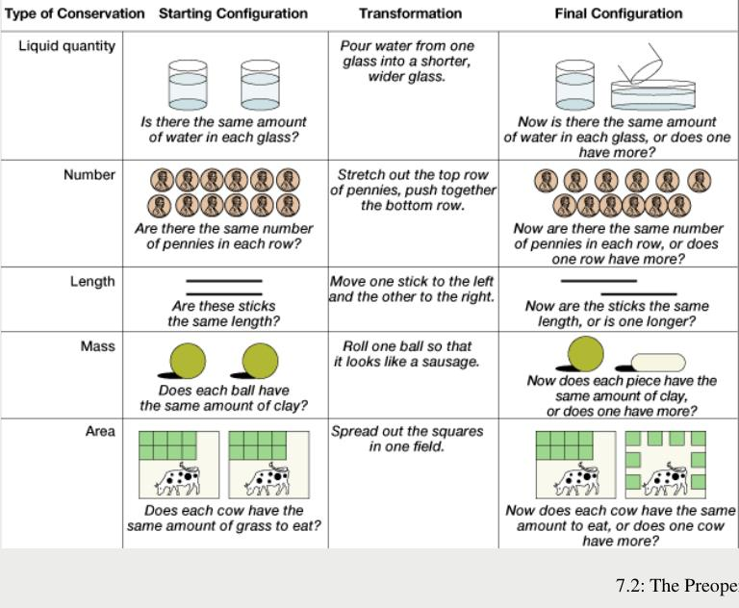

Slide 29
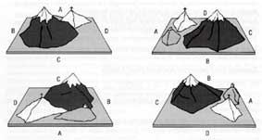
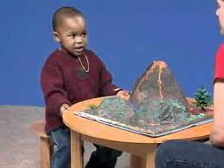
Example: Egocentrism

Slide 30
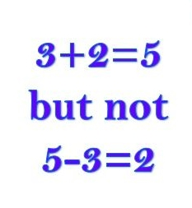
Example: Irreversibility
The child cannot mentally reverse the action and understand that the water could be poured back to look the same..

Slide 31
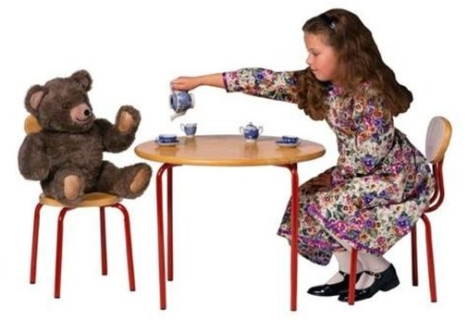
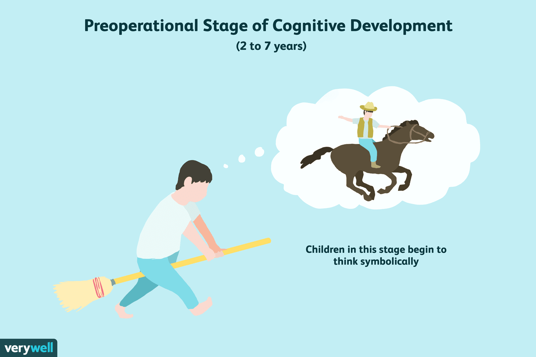
Example: Animism

Slide 32
Concrete operational stage
7-11 yrs
The child is now capable of performing logical operations, but only in the presence of actual objects. They can conserve, and show reversibility and more logical classification. They are less ego-centric.
One remaining problem for the concrete operational child is transitivity tasks. For example, if told that ‘Alan is taller than Nigel, and Nigel is taller than Charlie’ and asked whether Alan or Charlie is taller, children under 11 cannot solve this problem entirely in their heads. They can usually only solve it using real (or concrete) objects (such as dolls).

Slide 33
Formal operational stage
11 + yrs
  Children are able to think logically and systematically about both concrete and abstract problems, form hypotheses, and test them in a thoughtful way

Slide 34
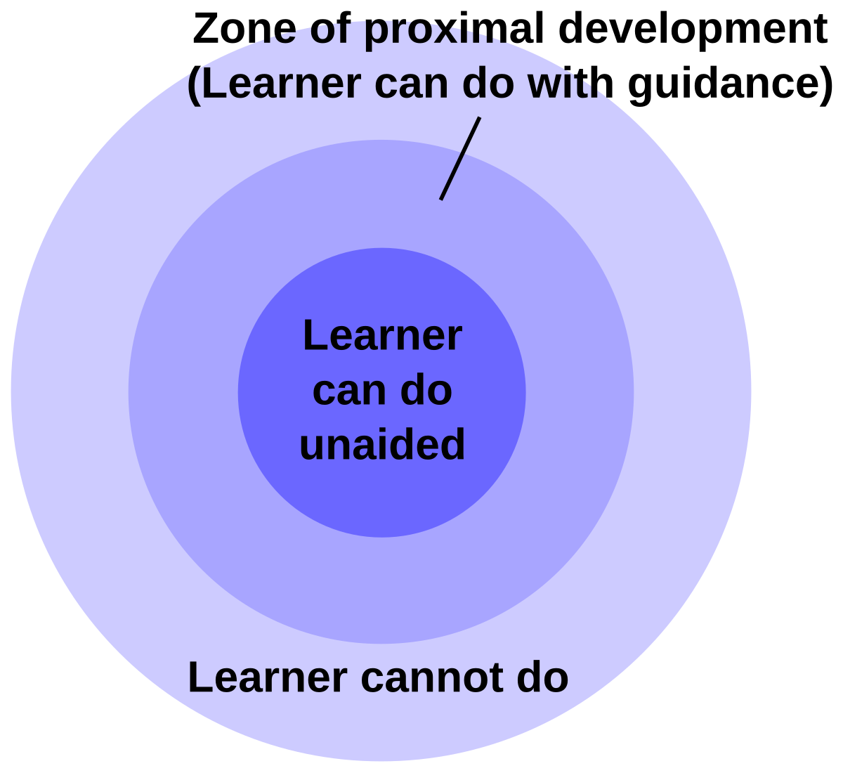
An alternative model?
Vygotsky, in contrast to Piaget (and the information-processing approach), sees the child as a participant in an interactive process, by which socially – and culturally – determined knowledge and understanding gradually become individualised.
Zone of Proximal Development
  Scaffolding - The help provided by a more knowledgeable other within the ZPD

Slide 35
Lecture summary
Attachment and key figures (Harlow, Bowlby, Ainsworth); attachment styles
Self-concept (Gallup’s study)
Cognitive development and Piaget’s Theory (Four stages, assimilation and accommodation)
Vygotsky - ZPD

